Slide 1
Fixed point iteration

Slide 2
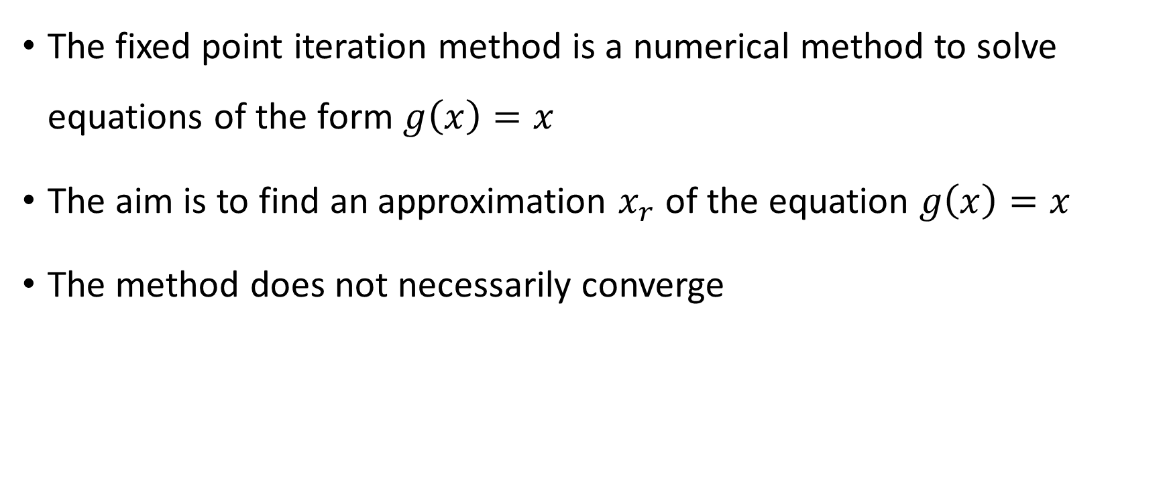
The fixed point iteration method is a numerical method to solve equations of the form $g\left(x\right)=x$
The aim is to find an approximation $x_{r}$ of the equation $g\left(x\right)=x$
The method does not necessarily converge
Notes:
In this lecture we cover a first example of an open method: the fixed-point iteration method
The fixed point iteration method solves numerically equations of the form g(x)=x.
Pay particular attention to the difference, compared to to the previous methods, where the equation was of the form f(x)=0.
The fixed point iteration method aims to approximate the solution r of the equation g(x)=x
In mathematics the solution r of an equation x=g(x) is termed a fixed point of the function g. This explains the name given to the algorithm.
As we will see, the algorithm will not necessarily converge.

Slide 3

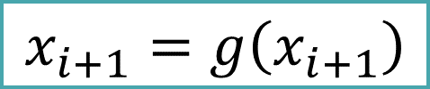
The algorithm needs to be provided with an initial guess $x_{o}$
The algorithm computes then successive approximations of the solution of the equations according the rule:
$$x_{i+1}=g\left(x_{i+1}\right)$$
Notes:
As any open method, one has to provide a first initial guess xo to start the algorithm.
The algorithm doesn’t give this initial guess. It is up to you to provide it.
You can do this based on a graphical solution of the equation or any other method, such as educated guess for example.
The algorithm will then provide further approximations of the solution of the equation g(x)=x by iteration according xi+1=g(xi).
You can see this algorithm as a brute force method. If xi would be the solution of the equation g(x)=x, then g(xi) would give xi.
In general it will not give xi, unless you are very lucky and accidently found the solution of the equation. So g(xi) will give another value than xi, say xi+1.
As you didn’t find the solution you try again with this new value xi+1.
You would go on like this until you reach the solution. This of course will never happen (expect in special cases). So you will stop the iterations once you consider you have reached your desired precision.
We will see later how you can estimated the error in each iteration.
For the moment let us first try to understand why this algorithm is supposed to converge towards the solution of g(x)=x.

Slide 4











Cobweb diagram
$$y$$
$$y=x$$
$$y=g(x)$$
$$x=g(x)$$
$$x_{1}=g\left(x_{o}\right)$$
$$x_{2}=g\left(x_{1}\right)$$
$$r$$
$$x_{2}$$
$$x_{1}$$
$$x_{o}$$
$$x$$
Notes:
To understand why the fixed point iteration method is converging to a solution of the equation x=g(x) let us solve this equation graphically
For this we first plot the function y=g(x).
We further add the function y=x.
The intercept of these two curves is a solution r of the equation x=g(x).
Let us now choose an initial guess xo.
To determine x1 we compute g(xo).
Let us report x1 on the x-axis and proceed by computing g(x1) to determine x2.
Again we report x2 on the x-axis.
We could proceed like this further to determine successively x3, x4 and so on.
Usually one presents these operations in a simplified way on the figure as highlighted by the bold arrows.
Such a figure is often referred to as a cobweb diagram.
Note how, in a staircase type evolution, the algorithm progressively converges towards to the solution r of the equation.

Slide 5
























$$y$$
$$y=x$$
$$y=g(x)$$
$$y$$
$$y=x$$
$$y=g(x)$$
$$r$$
$$r$$
$$x_{o}$$
$$x$$
$$x_{o}$$
$$x$$
(a)
(b)
$$y$$
$$y=g(x)$$
$$y$$
$$y=g(x)$$
$$y=x$$
$$y=x$$
$$r$$
$$r$$
$$x_{o}$$
$$x$$
$$x_{o}$$
$$x$$
(c)
(d)
Notes:
We saw how the fixed point method can converge to the root of the equation x=g(x).
This doesn’t always happen.
On the four cobweb diagrams you see are depicted the four typical cases that can occur.
Situation (a) we know already.
The algorithm converges in a staircase-like evolution towards the root.
Situation (b) is as well a case where the algorithm will converge.
The evolution is not a staircase-like type but rather like a spiral which progressively closes around the root.
Situations (c) and (d) are two cases where the algorithm diverges.
In case (c) the algorithm is driven away from the solution in a stair-case type evolution.
You can see it as the opposite case of situation (a).
Likewise, situation (d) is the opposite case of (b). The algorithms is driven in a spiral away from the root.
Observing these four cases we can draw some interesting conclusions
First we note that if the function g(x) has a positive slope, as in situations a and c, the evolution is a staircase.
For a negative slope of g(x) we get a spiral type evolution.
The slope of g(x) decides as well if the algorithm will converge or diverge.
If the slope is low then the algorithm converges
For steeper function it will diverge.
What is the critical slope of g(x)?
Comparing it with the function y=x gives the answer
The algorithm converges if g(x) has a slope less than one
For a stiffer function, a slope higher than one, the algorithm will diverge.
This observation is correct as shows the following theorem.

Slide 6
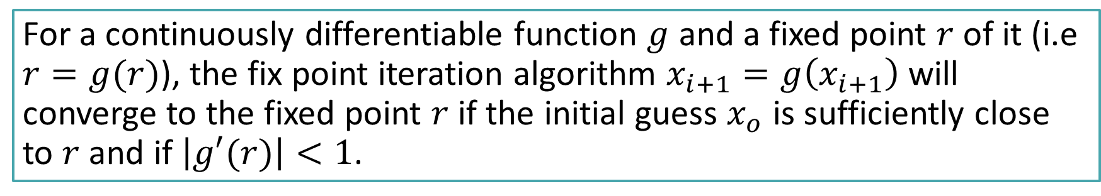
Convergence theorem for fixed point iteration
For a continuously differentiable function $g$ and a fixed point $r$ of it (i.e $r=g(r)$), the fix point iteration algorithm $x_{i+1}=g\left(x_{i+1}\right)$ will converge to the fixed point $r$ if the initial guess $x_{o}$ is sufficiently close to $r$ and if $\left|g′(r)\right|<1$.
Notes:
On can prove that if the function g(x) has a slope less than one, in absolute value, then the algorithm will converge.
The precise formulation says :
First: the slope of g(x) must be less than one in the root
And second: the initial guess xo must be reasonably close to the root.
What means reasonably close?
This heavily depends on the shape of the function g(x). No simple general criteria can be given
Practically, plotting the function g(x) and trying some values for xo will allow to check if the algorithm will converge or not.
Let us insist that to verify that g’(xo)<1 is not enough to guarantee that algorithm will converge.

Slide 7
Notes:
Let us illustrate this theorem with an example.
Consider the equation x^3+x-1=0
If we want to apply the fixed point method we first have to transform this equation into the form x=g(x).
The way to make this rearrangement is of course not unique
For example we could choose x =1-x^3
Or we could chose x=(1-x)^(1/3)
Many other ways are possible.
Here we show a third possible rearrangement.
Even if not obvious, but this equation is really the same as the original one. You may want to try to prove it.
In summary we see here three different possible choices for the function g(x).
Will they all converge?
Let us try out.

Slide 8
Notes:
Let us chose xo=0.5 and apply the fixed point method with the three functions g(x) we have built.
We conduct 20 iterations
As we can observe, the first choice of g(x) doesn’t converge. It oscillates between 0 and 1 but never converges to a fixed point.
This function doesn’t allow us to solve the problem
The two other choices converges.
In this case both to the same root.
But we can note that the third choice converges slightly faster.
The lesson to learn here is that for a given equation there is not a unique choice for the function g(x).
Many choices are possible. Some of them may converge, some may not
There is no general rule how to find a function g that will converge. Sometimes one has to try a few of them before finding a converging one.

Slide 9

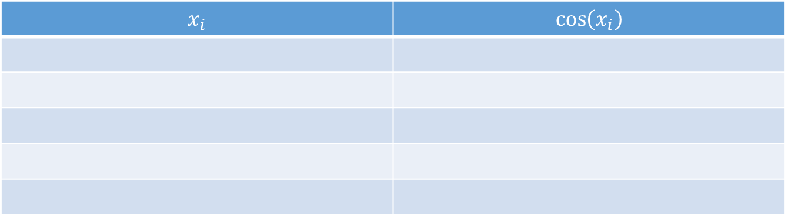

An example
$$x=\cos{x}$$
$$x_{i+1}=cos⁡\left(x_{i}\right)$$
$$x_{i}$$ | $$\cos\left(x_{i}\right)$$
Notes:
Let us now do a simple numerical example.
For this example we want to solve the equation x=cos(x).
The fix point iteration algorithm will write xi+1 = cos(xi)

Slide 10
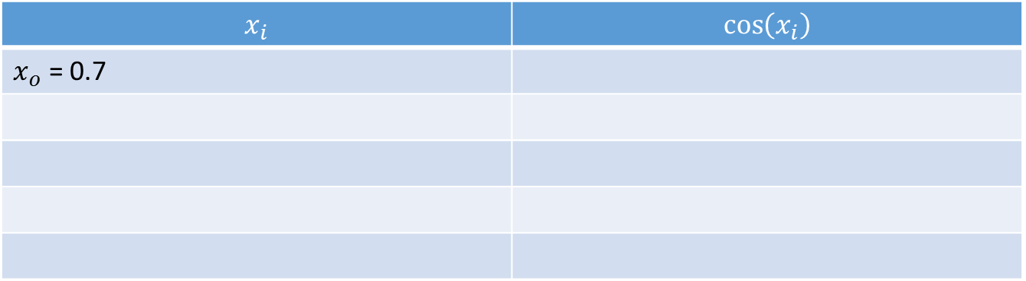
An example
$$x=cos⁡x$$
$$x_{i+1}=cos⁡\left(x_{i}\right)$$
$$x_{i}$$ | $$\cos\left(x_{i}\right)$$
$x_{o}$ = 0.7
Notes:
We need an initial guess
A good way to find one is to plot the cosine function and the function y=x. From such a plot one can chose an initial guess near the root
I encourage you to try to plot these functions.
For now let us choose xo=0.7

Slide 11
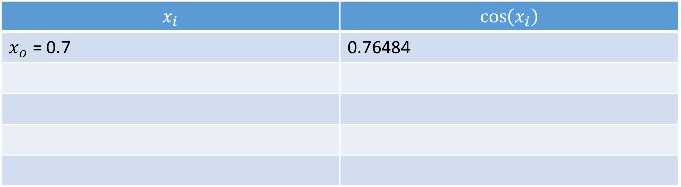
An example
$$x=\cos{x}$$
$$x_{i+1}=cos⁡\left(x_{i}\right)$$
$$x_{i}$$ | $$\cos\left(x_{i}\right)$$
$x_{o}$ = 0.7 | 0.76484
Notes:
To apply the algorithm we start computing x1 by applying g(x) to xo. That is computing cos(xo).
We find 0.76484
Do not forget to switch your calculator to radian mode.

Slide 12
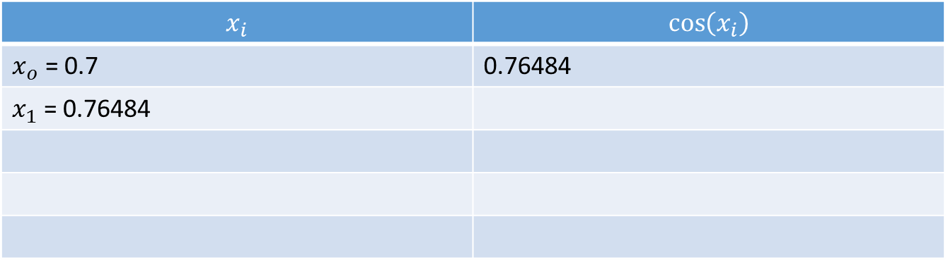
An example
$$x=\cos{x}$$
$$x_{i+1}=cos⁡\left(x_{i}\right)$$
$$x_{i}$$ | $$\cos\left(x_{i}\right)$$
$x_{o}$ = 0.7 | 0.76484
$x_{1}$ = 0.76484
Notes:
Using the found value of cos(xo) we can report the value of x1 in the first column of the table

Slide 13
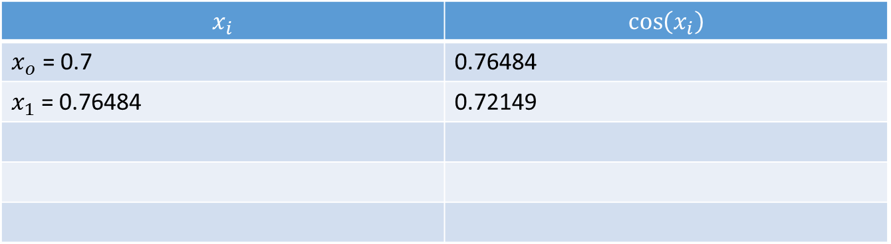
An example
$$x=\cos{x}$$
$$x_{i+1}=cos⁡\left(x_{i}\right)$$
$$x_{i}$$ | $$\cos\left(x_{i}\right)$$
$x_{o}$ = 0.7 | 0.76484
$x_{1}$ = 0.76484 | 0.72149
Notes:
From x1 we compute now cos(x1)

Slide 14
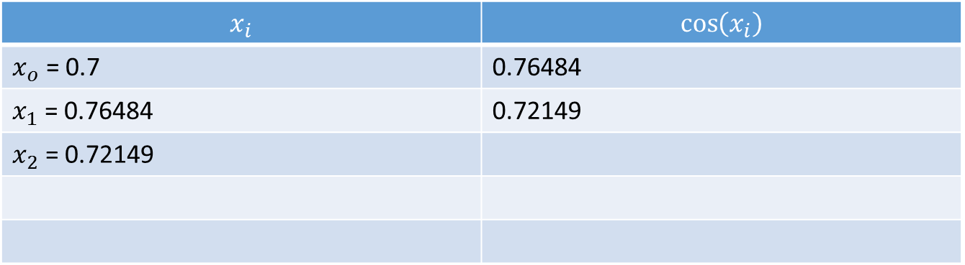
An example
$$x=\cos{x}$$
$$x_{i+1}=cos⁡\left(x_{i}\right)$$
$$x_{i}$$ | $$\cos\left(x_{i}\right)$$
$x_{o}$ = 0.7 | 0.76484
$x_{1}$ = 0.76484 | 0.72149
$x_{2}$ = 0.72149
Notes:
Which gives us x2

Slide 15
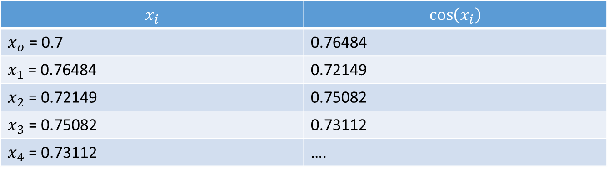
An example
$$x=cos⁡x$$
$$x_{i+1}=cos⁡\left(x_{i}\right)$$
$$x_{i}$$ | $$\cos\left(x_{i}\right)$$
$x_{o}$ = 0.7 | 0.76484
$x_{1}$ = 0.76484 | 0.72149
$x_{2}$ = 0.72149 | 0.75082
$x_{3}$ = 0.75082 | 0.73112
$x_{4}$ = 0.73112 | ….
Notes:
Going on the same way we can progressively compute x3 x4 and so on
Obviously the question raises until when should we continue.
In fact we want to go on until our approximation is good enough, meaning close enough to the root.
But how do we know how far, or how close, our approximation is from the actual root?
Addressing this question is our next target.

Slide 16
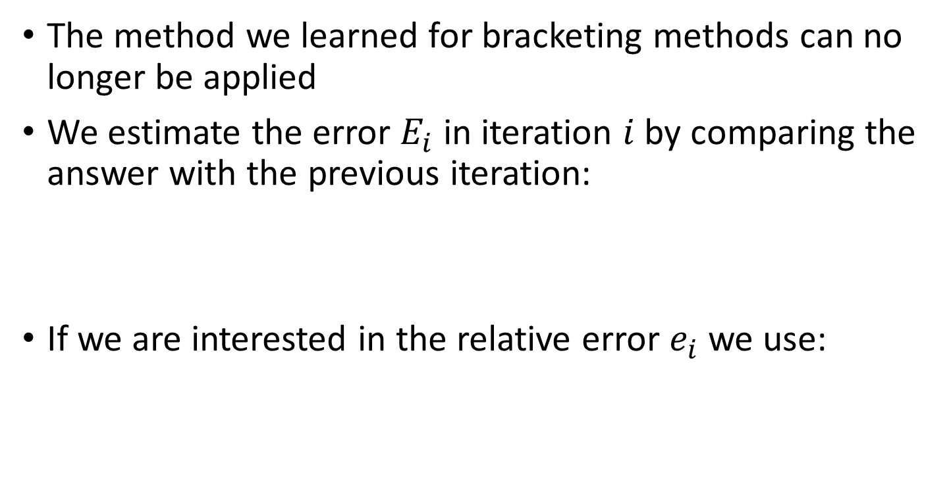


How to estimate the error?
The method we learned for bracketing methods can no longer be applied
We estimate the error $E_{i}$ in iteration $i$ by comparing the answer with the previous iteration:
If we are interested in the relative error $e_{i}$ we use:
x_{i}
$$E_{i}≅\left|x_{i}−x_{i−1}\right|$$
$$e_{i}≅\left|\frac{x_{i}−x_{i−1}}{x_{i}}\right|$$
Notes:
As of now we know how to apply the mechanics of the fixed point iteration algorithm. We know as well that under the right conditions, the algorithm will converge to the desired solution., meaning that the produced approximations become closer and closer to the answer of our problem.
But how good are our approximations? We would like to be able to estimate the error of a calculated approximation.
The method we learned for bracketing methods can no longer be applied. Indeed, open methods, such as the fixed point iteration method we are now studying, do not provide bracketing intervals.
So far, the only way we have to estimate the error of our approximation at iteration number i, is to compare it with the previous approximation.
Basically we say that, as the algorithm provides better and better approximations, the difference between two consecutive approximations is an estimation of the error.
If we are interested in the relative error rather than the absolute error we can use the ratio between xi-xi-1 and xi.

Slide 17

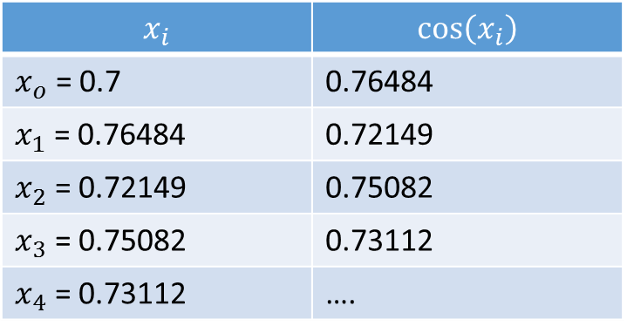
An example
$$x=cos⁡(x)$$
$$x_{i+1}=cos⁡\left(x_{i}\right)$$
$$x_{i}$$ | $$\cos\left(x_{i}\right)$$
$x_{o}$ = 0.7 | 0.76484
$x_{1}$ = 0.76484 | 0.72149
$x_{2}$ = 0.72149 | 0.75082
$x_{3}$ = 0.75082 | 0.73112
$x_{4}$ = 0.73112 | ….
Notes:
Let us illustrate this idea with an example.
We consider again our equation x=cos(x) and the corresponding fixed point iteration method which writes then xi+1=cos(xi).
Previously we filled out the displayed table.

Slide 18

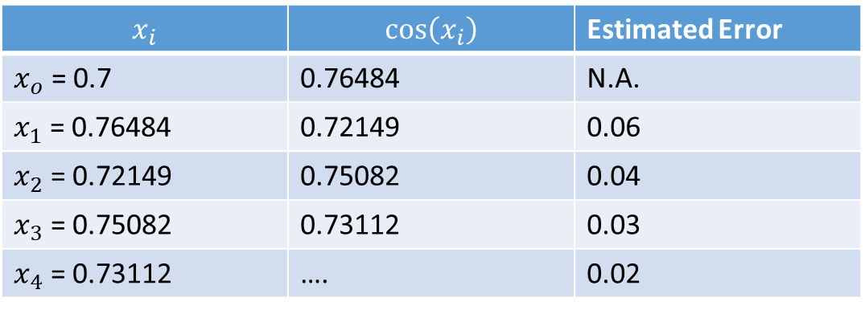
An example
$$x=cos⁡(x)$$
$$x_{i+1}=cos⁡\left(x_{i}\right)$$
$$x_{i}$$ | $$\cos\left(x_{i}\right)$$ | Estimated Error
$x_{o}$ = 0.7 | 0.76484 | N.A.
$x_{1}$ = 0.76484 | 0.72149 | 0.06
$x_{2}$ = 0.72149 | 0.75082 | 0.04
$x_{3}$ = 0.75082 | 0.73112 | 0.03
$x_{4}$ = 0.73112 | …. | 0.02
$$x_{r}=0.73±0.02$$
Notes:
Let us now add one column more in which we estimate the error at each iteration based on the formula xi-xi-1.
The computed estimated errors decrease and we can say that x4, the best approximation we computed in this example, has an error of about 0.02.
The best answer to the approximation xr of the equation x=cos(x) we can give based on this table is therefore xr=0.73 +/- 0.02

Slide 19

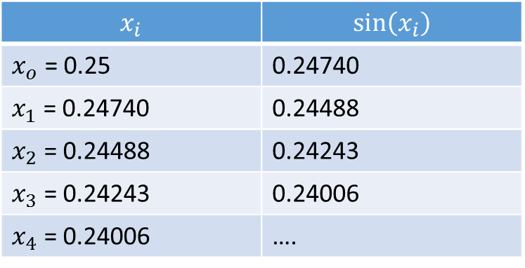

A counter example
$$x=sin⁡(x)$$
$$x_{i+1}=sin⁡\left(x_{i}\right)$$
$$x_{i}$$ | $$sin⁡\left(x_{i}\right)$$
$x_{o}$ = 0.25 | 0.24740
$x_{1}$ = 0.24740 | 0.24488
$x_{2}$ = 0.24488 | 0.24243
$x_{3}$ = 0.24243 | 0.24006
$x_{4}$ = 0.24006 | ….
Notes:
The method has however it’s limitations. For this let us consider the example of the equation x=sin(x).
As we know, x=0 is a solution of this equation. Let us try to see how well we can estimate this solution with our fixed step iteration method.
The fixed point iteration method writes xi+1=sin(xi)
Let us start the algorithm with xo=0.25 and perform four iterations

Slide 20
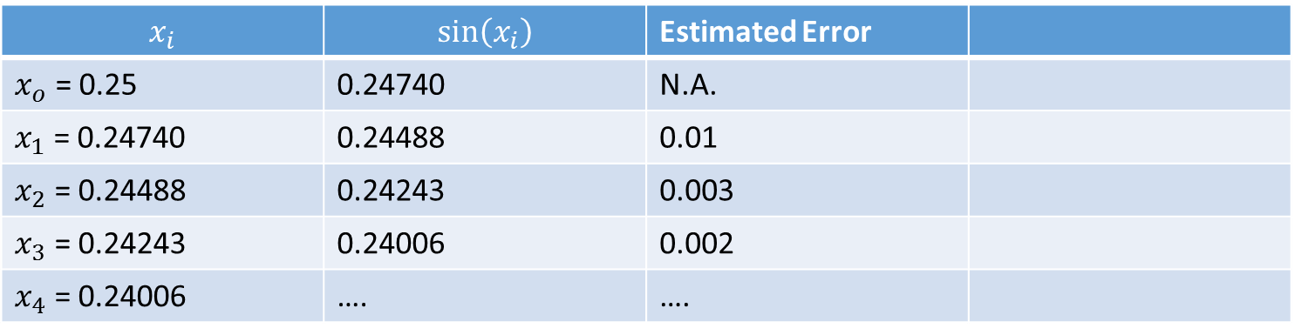
A counter example
$$x=sin⁡(x)$$
$$x_{i+1}=sin⁡\left(x_{i}\right)$$
$$x_{i}$$ | $$sin⁡\left(x_{i}\right)$$ | Estimated Error
$x_{o}$ = 0.25 | 0.24740 | N.A.
$x_{1}$ = 0.24740 | 0.24488 | 0.01
$x_{2}$ = 0.24488 | 0.24243 | 0.003
$x_{3}$ = 0.24243 | 0.24006 | 0.002
$x_{4}$ = 0.24006 | …. | ….
Notes:
Let us further add a column with the estimated errors.
According our estimations, the algorithm performs very well and seems to estimate the root very precisely with errors as low as 0.002 for iteration number 3.

Slide 21
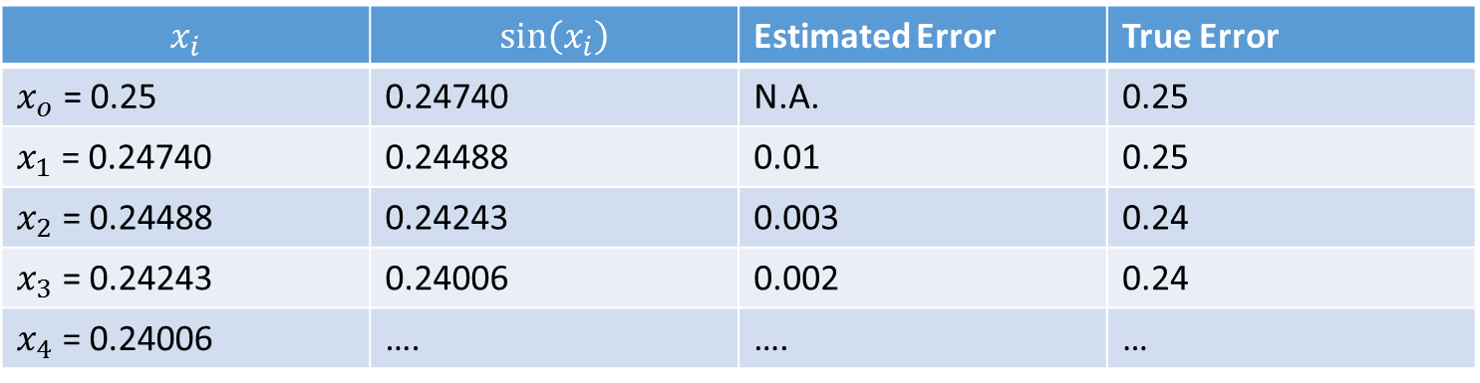
A counter example
$$x=sin⁡(x)$$
$$x_{i+1}=sin⁡\left(x_{i}\right)$$
$$x_{i}$$ | $$sin⁡\left(x_{i}\right)$$ | Estimated Error | True Error
$x_{o}$ = 0.25 | 0.24740 | N.A. | 0.25
$x_{1}$ = 0.24740 | 0.24488 | 0.01 | 0.25
$x_{2}$ = 0.24488 | 0.24243 | 0.003 | 0.24
$x_{3}$ = 0.24243 | 0.24006 | 0.002 | 0.24
$x_{4}$ = 0.24006 | …. | …. | …
Notes:
However if we compare our error estimates with the true errors we see that we are much too optimistic in estimating the errors.
We will understand later the reason of this strange behavior, but let us insist that it is not at all a none typical case.
As you can observe with this example, there is in fact no way for us to know that we applied the method to estimate errors in a situation were we are not allowed to do it. Nothing tells us if our error estimates are good or not. Here we only know it because we know the true answer.
In a real situation this is however not the case, as we will not know the true answer nor the true error.
In coming lectures we will have to learn more about how we can verify if our error estimates are actually good or bad estimations.
For the moment we have to postpone this discussion to further lectures and content us with our method, even if it is imperfect.

Slide 22
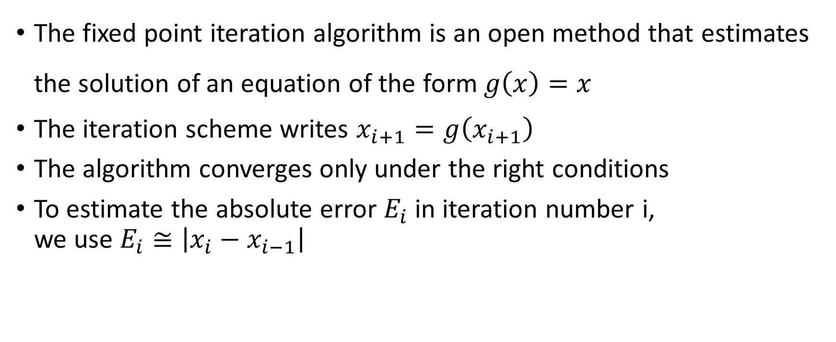
Summary
The fixed point iteration algorithm is an open method that estimates the solution of an equation of the form $g\left(x\right)=x$
The iteration scheme writes $x_{i+1}=g\left(x_{i+1}\right)$
The algorithm converges only under the right conditions
To estimate the absolute error $E_{i}$ in iteration number i, we use $E_{i}≅\left|x_{i}−x_{i−1}\right|$
Notes:
Let us summarizes the key findings
The fixed point iteration algorithm is an open method that estimates the solution of an equation of the form $g\left(x\right)=x$
The iteration scheme writes $x_{i+1}=g\left(x_{i+1}\right)$
The algorithm converges only under the right conditions
To estimate the absolute error $E_{i}$ in iteration number i, we use the difference between the current and previous iteration

